Slide 1
Text classification on EDOS dataset
Natural Language Processing Case Study – AY 2023/24
Ester Molinari

Slide 2
Summary
Introduction and motivations
Related work
Proposed approach
Evaluation
Conclusions and limitations

Slide 3
Introduction and motivations
Sexism can be difficult to detect from plain text and it is widely used in social media.
Task 10 of SemEval 2023 proposed the Explainable Detection of Online Sexism (EDOS) dataset along with three main tasks to solve:
Binary Sexism Detection (Task A)
Category of Sexism (Task B)
Fine-grained Vector of Sexism (Task C)

Slide 4
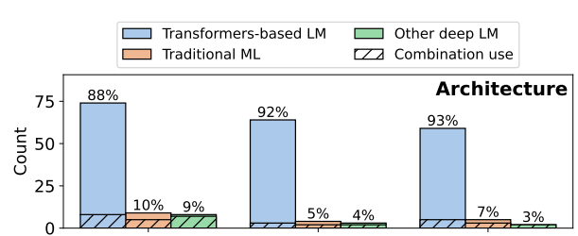
Related work
From SemEval final report [1]:
90% of partecipants used a transformer-based model (RoBERTa, DeBERTa, BERT, BERTweet, DistilBERT)
8% of partecipants used traditional machine learning methods
2% used non-transformer deep neural networks, often combined with other methods
[1] H. Kirk, W. Yin, B. Vidgen, P. Röttger, SemEval-2023 task 10: Explainable detection of online sexism

Slide 5
Related work
It has been proved that fine-tuned RoBERTa performs better than fine-tuned BERT on EDOS dataset for Task A [2].
Furthermore, using both fine-tuned models in an ensemble model performs better on Task B and Task C [3].
In a paper has been reported that the number of sexist data is comparatively low [4].
Adding extra-linguistic informations usually helps the models to solve all three proposed tasks [5].
[2] M. Padmavathi, Ds at semeval-2023 task 10: Explaining online sexism using transformer based approach
[3] D. Obeidat, H. Nammas, M. Abdullah, et al., Just_one at semeval-2023 task 10: Explainable detection of online sexism (edos)
[4] R. H. Rifat, A. Shruti, M. Kamal, F. Sadeque, Acsmkrhr at semeval-2023 task 10: Explainable online sexism detection (edos)
[5] M. E. V. Rodrguez, F. M. P. Del Arco, L. A. U. Lopez, M. T. Martín-Valdivia, Sinai at semeval-2023 task 10: Leveraging emotions, sentiments, and irony knowledge for explainable detection of online sexism

Slide 6
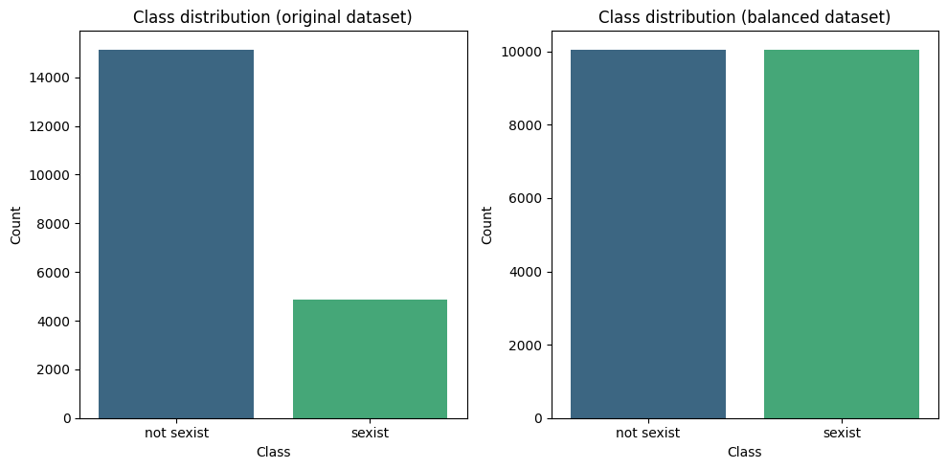
Proposed approach
Have been used two datasets:
The original EDOS dataset, and
The balanced EDOS dataset [6]
Performing data exploration allowed to find out that the original dataset was very unbalanced.
[6] A. Rydelek, D. Dementieva, G. Groh, AdamR at SemEval-2023 task 10: Solving the class imbalance problem in sexism detection with ensemble learning

Slide 7
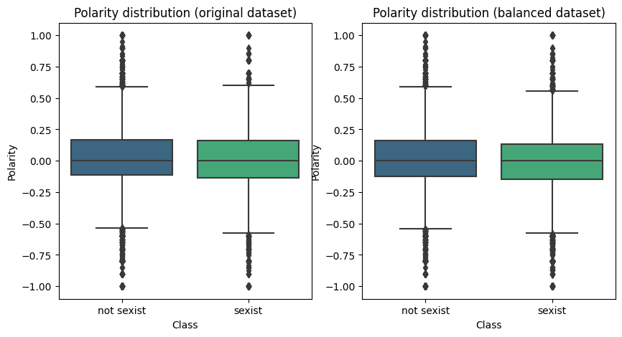
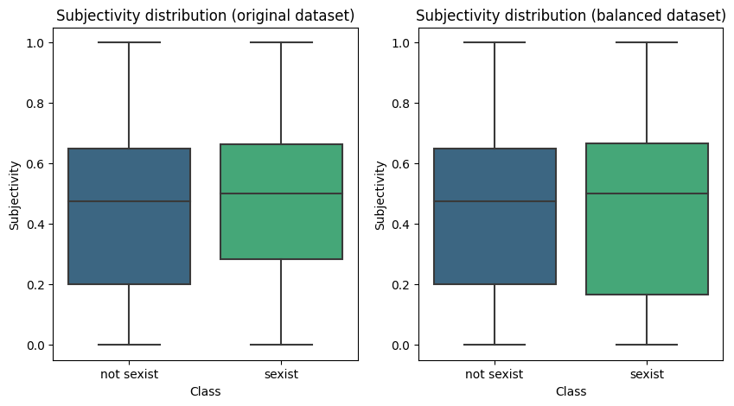
Proposed approach

Slide 8
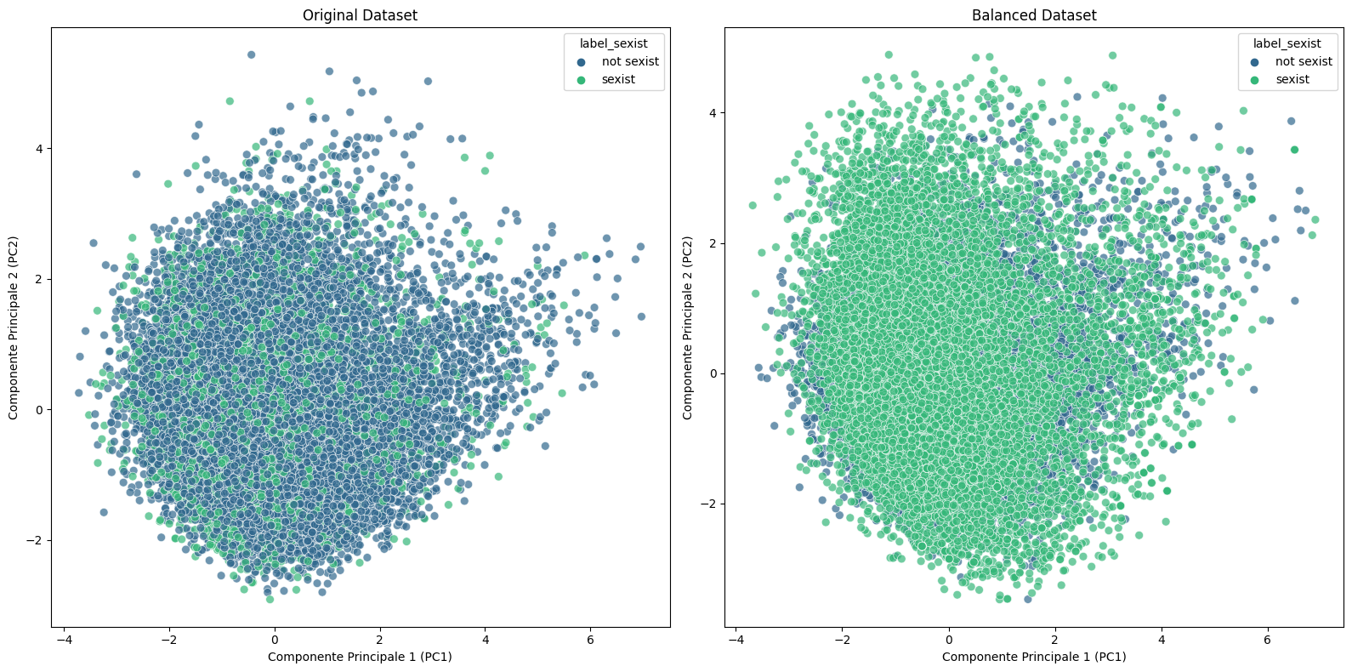
Proposed approach
By plotting sentences embeddings in a 2D space we also find out that out data is not linearly separable.
Three approaches are proposed:
Fine-tuning BERT for text classification
Logistic Regression on TF-IDF
Text classification with ngrams embeddings

Slide 9
1. Fine-tuning BERT for text classification
Transformer-based approach using bert-base-uncased BERT model.
The model has been fine-tuned on each datasets, and then tested on the same sentences for binary text classification.
Both models have the same optimizer with the same learning rate and they were trained on 3 epochs with a final loss of 0.106 on the original dataset and 0.138 on the balanced one.

Slide 10
2. Logistic regression on TF-IDF
TF-IDF-based logistic regression considering the non-linearity of the data.
Firstly, a TF-IDF vectorizer has been applied on both datasets sentences and labels have been mapped into numerical values, 1 if sexist, 0 otherwise.
This approach results of two logistic regression models with the same number of iterations, on the original dataset and on the balanced one. They have been tested on the same sentences.

Slide 11
3. Text classification with ngrams embeddings
Ngram embedding-based approach supported by a majority voting on cosine similarity. This approach does not need any training and it is non-parametric.
Trigrams are extracted from sexist and not sexist sentences and then converted into embeddings to allow similarity computation with the input sentence.
Cosine similarity is computed between each input sentence trigram embedding and sexist and not sexist trigrams embeddings, allowing to measure the degree of sexism in a sentence. The predicted label is obtained by checking sexist and not sexist global mean from similarities.

Slide 12
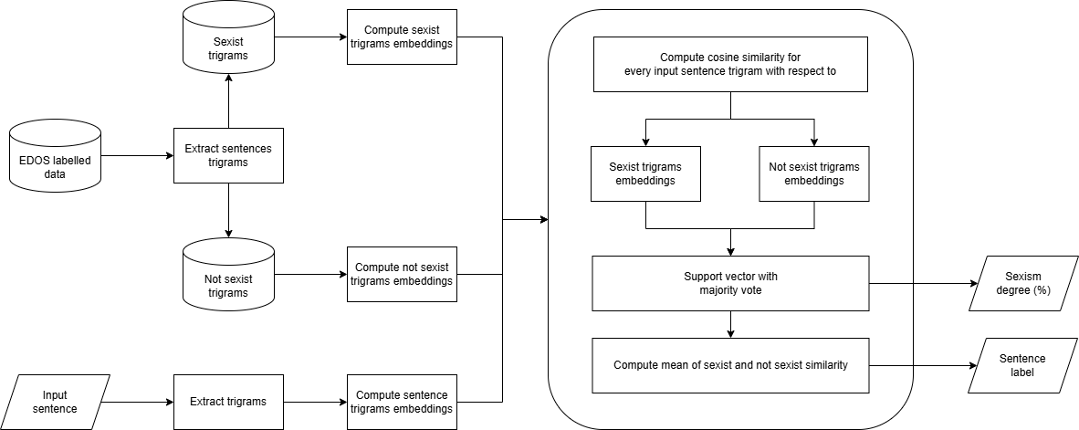
3. Text classification with ngrams embeddings

Slide 13
Input sentence
Go back in the kitchen and make me a sandwich
Input sentence trigrams
Go back in
back in the
in the kitchen
the kitchen and
kitchen and make
and make me
make me a
me a sandwich
Input sentence trigrams embeddings
E1
E2
E3
E4
E5
E6
E7
E8

Slide 14
Input sentence trigrams embeddings
E1
E2
E3
E4
E5
E6
E7
E8
Sexist
emb
Similarity score: 1.00
E1
Not sexist
emb
Similarity score: 0.90

Slide 15
Input sentence trigrams embeddings
E1
E2
E3
E4
E5
E6
E7
E8
Sexist
emb
Similarity score: 1.00
E1
Not sexist
emb
Similarity score: 0.90
Similarity scores (sexist)
Similarity scores (not sexist)
1.00
0.90

Slide 16
Input sentence trigrams embeddings
Go back in
E2
E3
E4
E5
E6
E7
E8
Sexist
emb
Similarity score: 0.67
E2
Not sexist
emb
Similarity score: 1.00
Similarity scores (sexist)
Similarity scores (not sexist)
1.00
0.67
0.90
1.00

Slide 17
Input sentence trigrams embeddings
Go back in
back in the
E3
E4
E5
E6
E7
E8
Sexist
emb
Similarity score: 1.00
E3
Not sexist
emb
Similarity score: 0.79
Similarity scores (sexist)
Similarity scores (not sexist)
1.00
0.67
1.00
0.90
1.00
0.79

Slide 18
Input sentence trigrams embeddings
Go back in
back in the
in the kitchen
E4
E5
E6
E7
E8
Sexist
emb
Similarity score: 1.00
E4
Not sexist
emb
Similarity score: 0.86
Similarity scores (sexist)
Similarity scores (not sexist)
1.00
0.67
1.00
1.00
0.90
1.00
0.79
0.86

Slide 19
Input sentence trigrams embeddings
Go back in
back in the
in the kitchen
the kitchen and
kitchen and make
and make me
make me a
me a sandwich
Support vector
1
0
1
1
1
1
0
1
The sentence «Go back in the kitchen and make me a sandwich» is sexist (75%).
Possible sexist trigram is «in the kitchen».
Similarity scores (sexist)
Similarity scores (not sexist)
1.00
0.87
1.00
1.00
0.99
1.00
0.81
1.00
0.90
1.00
0.79
0.86
0.92
0.72
0.87
0.77

Slide 20
Input trigram | Sexist trigram | Sexist score | Not sexist trigram | Not sexist score
Go back in | go back in | 1.00 | get back in | 0.90
back in the | back into the | 0.87 | Back in the | 1.00
in the kitchen | IN THE KITCHEN | 1.00 | into a kitchen | 0.79
the kitchen and | the kitchen and | 1.00 | the kitchen You | 0.86
kitchen and make | kitchen and make | 0.99 | kitchen to make | 0.92
and make me | and make me | 1.00 | You make me | 0.72
make me a | make yourself a | 0.81 | make you an | 0.87
me a sandwich | me a sandwich | 1.00 | a sandwich oh | 0.77
 |  | Mean = 0.188 |  | Mean = 0.185

Slide 21
Evaluation
Using metrics and sentences

Slide 22
1. Fine-tuning BERT for text classification
 | Precision | Recall | F1-Score | Support
Not sexist | 0.88 | 0.95 | 0.92 | 3045
Sexist | 0.79 | 0.60 | 0.68 | 955
Accuracy |  |  | 0.87 | 4000
M. avg | 0.84 | 0.77 | 0.80 | 4000
W. avg | 0.86 | 0.87 | 0.86 | 4000
 | Precision | Recall | F1-Score | Support
Not sexist | 0.85 | 0.83 | 0.84 | 2005
Sexist | 0.84 | 0.86 | 0.85 | 2017
Accuracy |  |  | 0.85 | 4022
M.avg | 0.85 | 0.85 | 0.85 | 4022
W. avg | 0.85 | 0.85 | 0.85 | 4022
Original dataset
Balanced dataset
The balanced dataset helps the fine-tuning process with a better precision and recall on both sexist and not sexist sentences while the original dataset is too unbalanced.

Slide 23
1. Fine-tuning BERT for text classification
Sentence | Original | Balanced | Actual
Women are not suited for leadership roles | Sexist | Sexist | Sexist
The team worked together to achieve their goal | Not sexist | Not sexist | Not sexist
Go back in the kitchen and make me a sandwich | Not sexist | Sexist | Sexist
Women are better than men | Not sexist | Sexist | Sexist
Woman driving, peril thriving | Not sexist | Sexist | Sexist
Stop talking like a Karen | Not sexist | Sexist | Sexist
If she breathes she’s a t*** | Sexist | Sexist | Sexist

Slide 24
2. Logistic regression on TF-IDF
 | Precision | Recall | F1-Score | Support
Not sexist | 0.82 | 0.97 | 0.89 | 3045
Sexist | 0.78 | 0.34 | 0.47 | 955
Accuracy |  |  | 0.82 | 4000
M. avg | 0.80 | 0.65 | 0.68 | 4000
W. avg | 0.81 | 0.82 | 0.79 | 4000
 | Precision | Recall | F1-Score | Support
Not sexist | 0.77 | 0.87 | 0.81 | 2005
Sexist | 0.85 | 0.74 | 0.79 | 2017
Accuracy |  |  | 0.80 | 4022
M.avg | 0.81 | 0.80 | 0.80 | 4022
W. avg | 0.81 | 0.80 | 0.80 | 4022
Original dataset
Balanced dataset
Again, the balanced dataset shows better results for both classes also on logistic regression with TF-IDF, taking into account that this approach is lightweight and does not use embeddings.

Slide 25
2. Logistic regression on TF-IDF
Sentence | Original | Balanced | Actual
Women are not suited for leadership roles | Not sexist | Sexist | Sexist
The team worked together to achieve their goal | Not sexist | Not sexist | Not sexist
Go back in the kitchen and make me a sandwich | Not sexist | Sexist | Sexist
Women are better than men | Not sexist | Sexist | Sexist
Woman driving, peril thriving | Not sexist | Sexist | Sexist
Stop talking like a Karen | Not sexist | Not sexist | Sexist
If she breathes she’s a t*** | Not sexist | Not sexist | Sexist

Slide 26
3. Text classification with ngrams embeddings
 | Precision | Recall | F1-Score | Support
Not sexist | 0.96 | 0.06 | 0.11 | 3045
Sexist | 0.25 | 0.99 | 0.40 | 955
Accuracy |  |  | 0.28 | 4000
M. avg | 0.61 | 0.53 | 0.25 | 4000
W. avg | 0.79 | 0.28 | 0.18 | 4000
 | Precision | Recall | F1-Score | Support
Not sexist | 0.88 | 0.06 | 0.11 | 2005
Sexist | 0.51 | 0.99 | 0.68 | 2017
Accuracy |  |  | 0.53 | 4022
M.avg | 0.69 | 0.53 | 0.39 | 4022
W. avg | 0.69 | 0.53 | 0.40 | 4022
Original dataset
Balanced dataset
These are the most interesting results. By using the same metrics as the first two approaches, this approach seems to be the worst on not sexist sentences recall. As a binary classification, an accuracy of 0.53 is quite bad for the predictions.

Slide 27
3. Text classification with ngrams embeddings
Sentence | Original | Balanced | Actual
Women are not suited for leadership roles | Sexist (100%) | Sexist (80%) | Sexist
The team worked together to achieve their goal | Sexist (0%) | Sexist (50%) | Not sexist
Go back in the kitchen and make me a sandwich | Sexist (63%) | Sexist (75%) | Sexist
Women are better than men | Sexist (0%) | Sexist (67%) | Sexist
Woman driving, peril thriving | Sexist (0%) | Sexist (50%) | Sexist
Stop talking like a Karen | Sexist (33%) | Sexist (33%) | Sexist
If she breathes she’s a t*** | Sexist (60%) | Sexist (100%) | Sexist
Yesterday I went to the store and I bought a cake | Not sexist (100%) | Sexist (67%) | Not sexist
Original sexist trigram – Balanced sexist trigram – Original and balanced sexist trigram

Slide 28
Conclusions and limitations
The most interesting approach is the last one based on ngrams because it seems to return an «explanation» on the prediction.
The logistic regression is a good alternative to transformer-based approaches for Task A.
Observations:
Find a suitable metric for the ngram approach
Create a better dataset for the ngram approach to achieve better results
Extract better ngrams dynamically

